Slide 1
Air Pollution Hotspots identification
Course Title: Data Mining
Vatsal Vaghasiya
25ETCS115018
25ETCS115018@msruas.ac.in

Slide 2
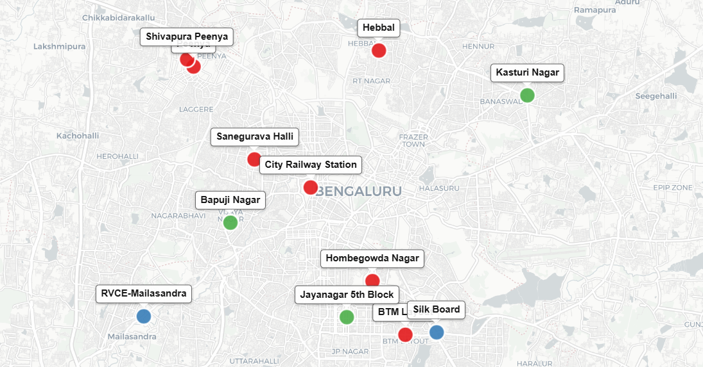
AIM
To identify air pollution hotspots in Bangalore using machine learning clustering techniques on CPCB monitoring data.

Slide 3
OBJECTIVES
To Design a data preprocessing pipeline for multi-pollutant sensor data normalization
To Implement data normalization techniques (Min-Max/Standard Scaler) for sensor readings.
To Test three clustering models: K-Means, DBSCAN, and Hierarchical
To Evaluate spatial distribution of clusters across Bangalore
To show spatial visualization of pollution hotspots

Slide 4
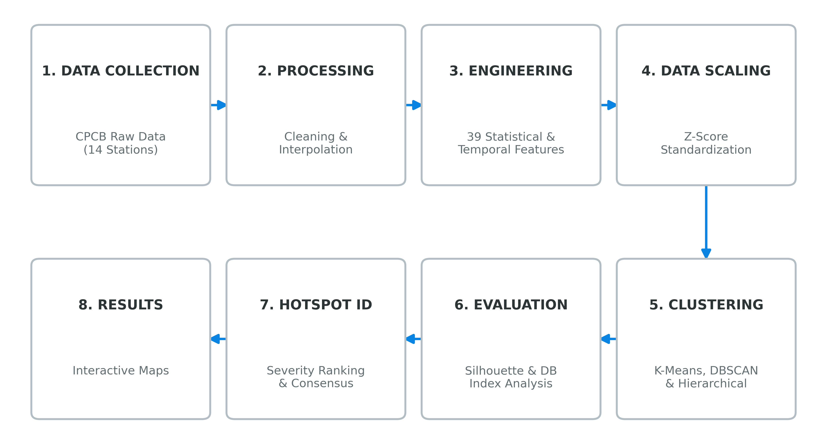
Methodology Pipeline

Slide 5
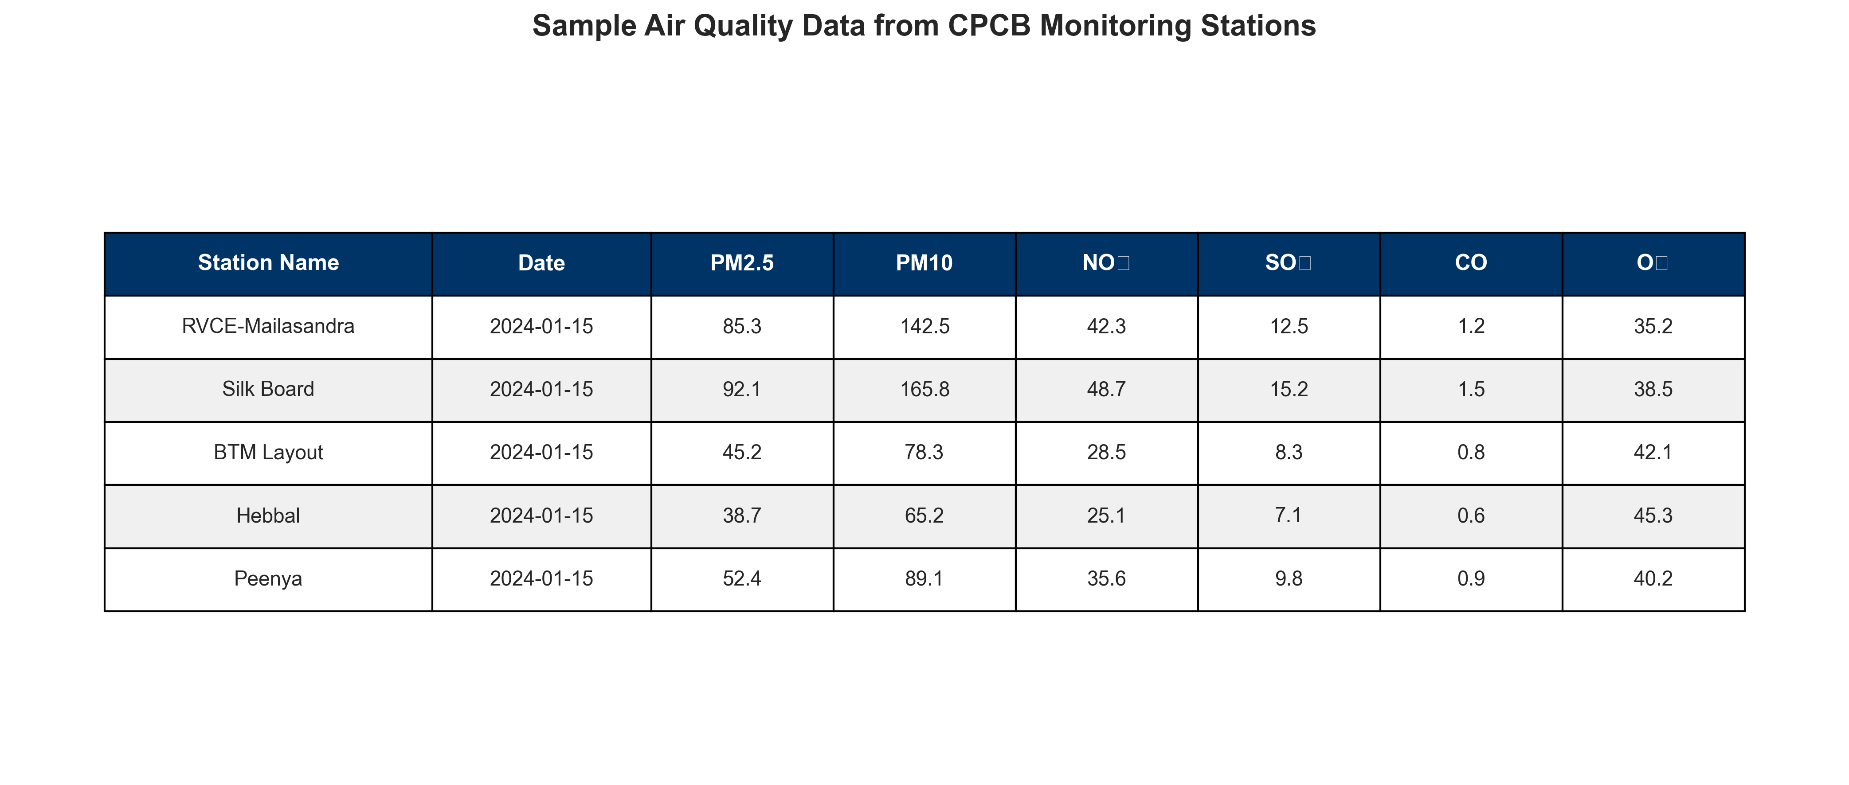
Dataset Overview
Source: Central Pollution Control Board (CPCB), Government of India
Pollutants: PM2.5, PM10, NO2, SO2, CO, Ozone (O3)
Coverage: 14 monitoring stations across Bangalore
Period: Daily AQI readings for 2024

Slide 6
Data Preprocessing & Normalization
Why Normalization is Critical:
Different pollutants have vastly different measurement scales:
PM2.5: 0-500 μg/m³
CO: 0-10 mg/m³
NO2: 0-200 μg/m³
Without normalization, clustering algorithms would be biased toward pollutants with larger numerical ranges.
Technique Applied:
- Standard Scalar (Z-score normalization)
Result:
All features on comparable scale for fair clustering

Slide 7
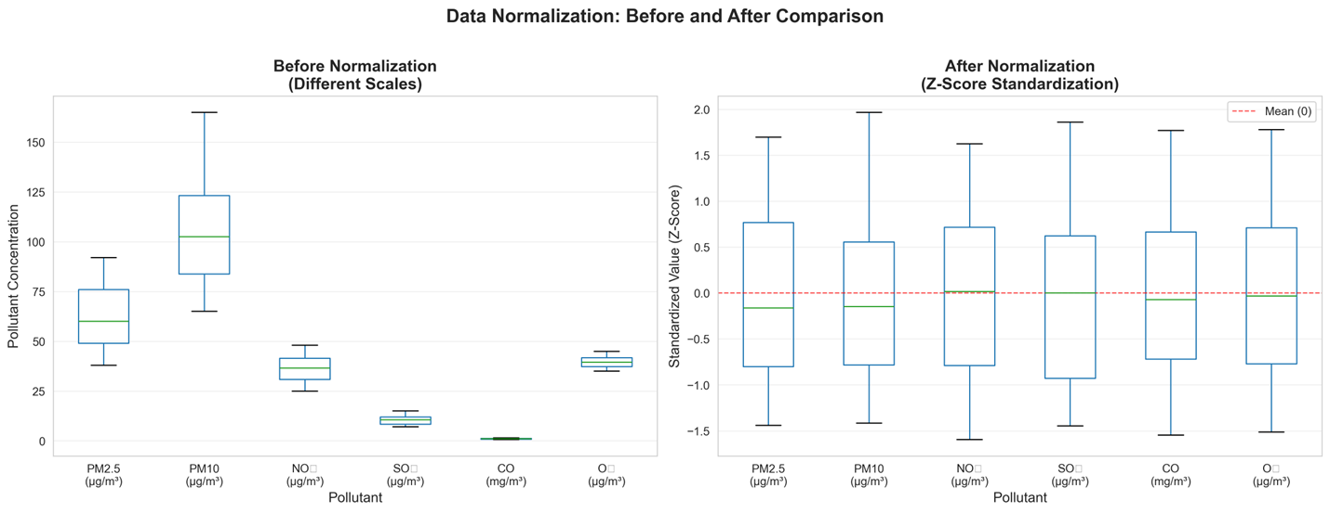
Data Preprocessing & Normalization

Slide 8
Clustering Models Used
Three Models Implemented:
1. K-Means Clustering
Type: Partitioning-based
How it works: Divides data into K clusters by minimizing within-cluster variance
Use case: When cluster count is known and data is well-separated
2. DBSCAN (Density-Based Spatial Clustering of Applications with Noise)
Type: Density-based
How it works: Groups points in high-density regions, marks low-density points as outliers
Use case: When outlier detection is important and cluster shapes vary

Slide 9
Clustering Models Used
3. Hierarchical Clustering
Type: Hierarchical
How it works: Builds a tree of clusters from bottom-up, merging similar clusters
Use case: When understanding cluster hierarchy matters

Slide 10
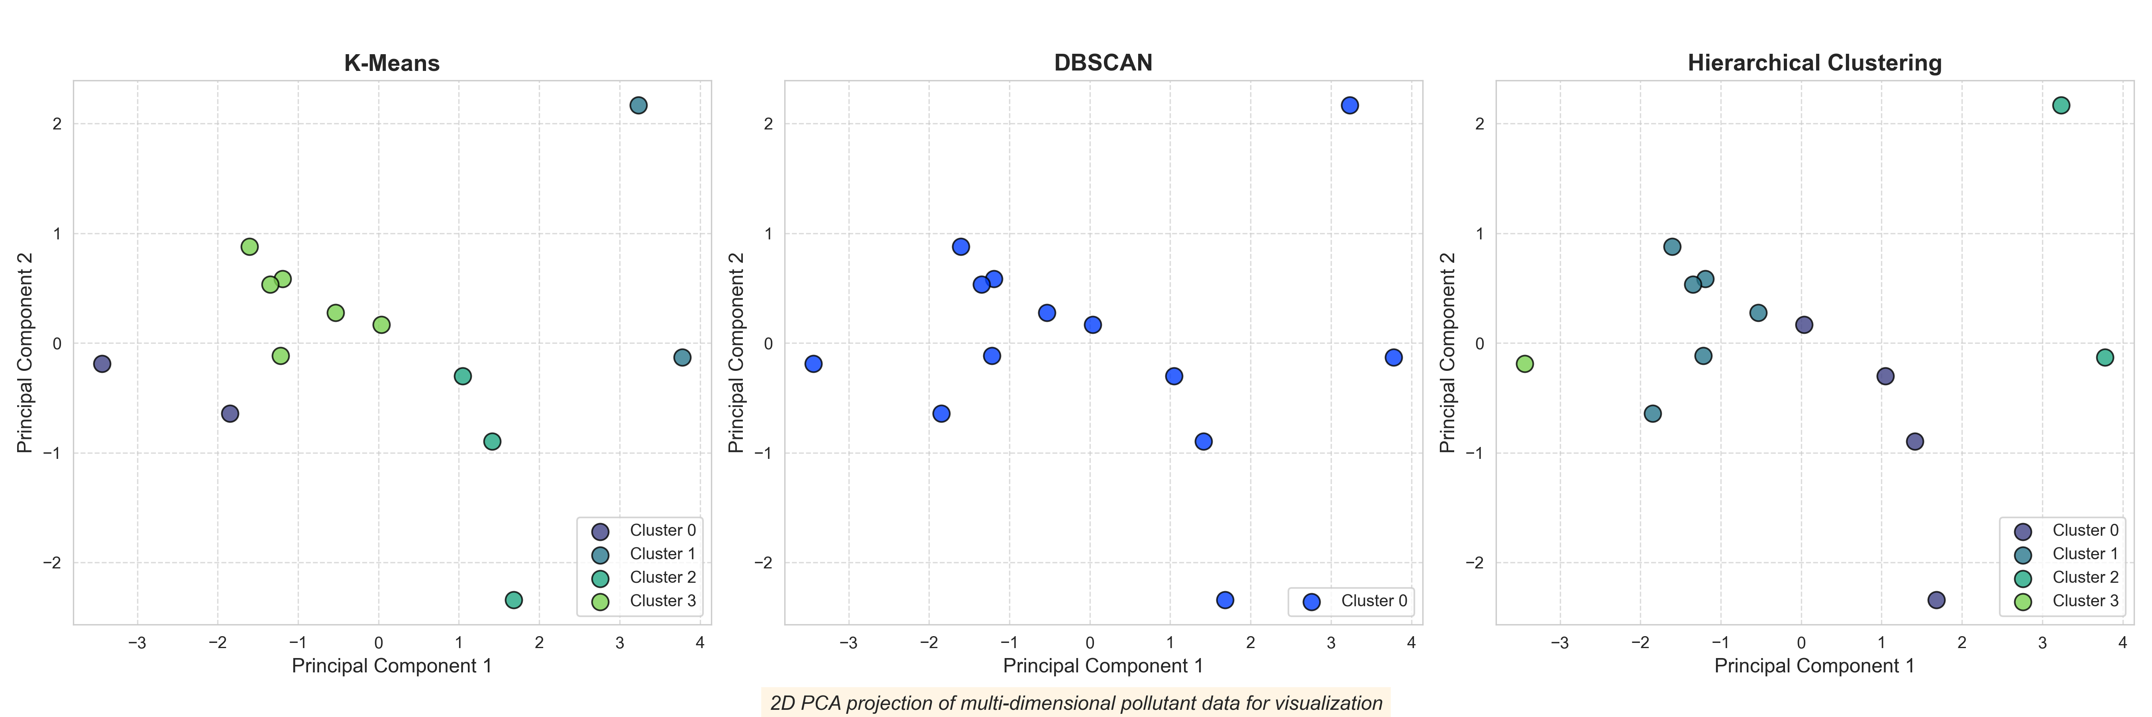
PCA projection of Clusters

Slide 11
DETERMINING OPTIMAL CLUSTERS
Challenge: How many clusters should we create?
Methods Used:
1. Elbow Method
Plot inertia (within-cluster sum of squares) vs. number of clusters
Look for the "elbow point" where improvement gets stable.
2. Silhouette Analysis
Calculate silhouette score for K = 2 to 10
Higher score means better-defined clusters
Choose K that maximizes average silhouette score
3. Domain Knowledge
Air quality typically categorized as: Good, Moderate, Poor, Severe
Suggests 3-4 natural groupings

Slide 12
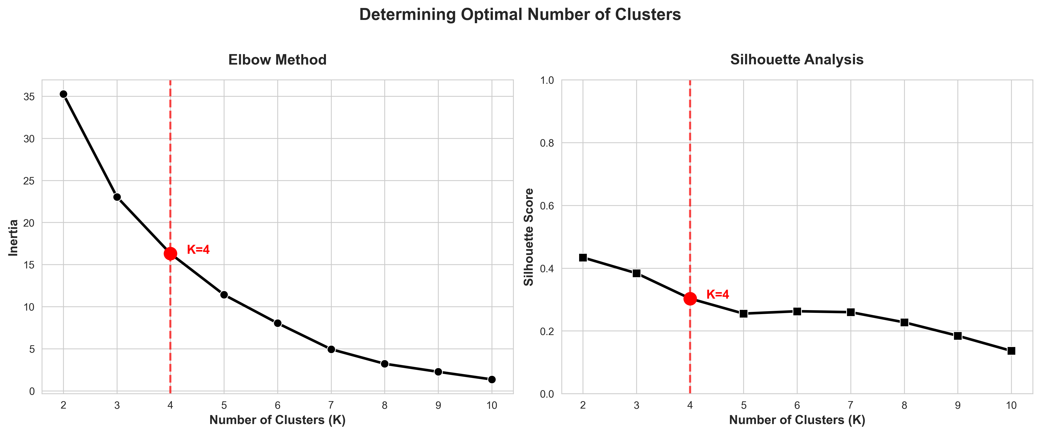
DETERMINING OPTIMAL CLUSTERS

Slide 13
DETERMINING OPTIMAL CLUSTERS
Based on elbow method and silhouette analysis, K = 4 clusters was selected:
Cluster 0: Low pollution zones
Cluster 1: Moderate pollution areas
Cluster 2: High pollution hotspots
Cluster 3: Industrial/traffic-influenced zones

Slide 14
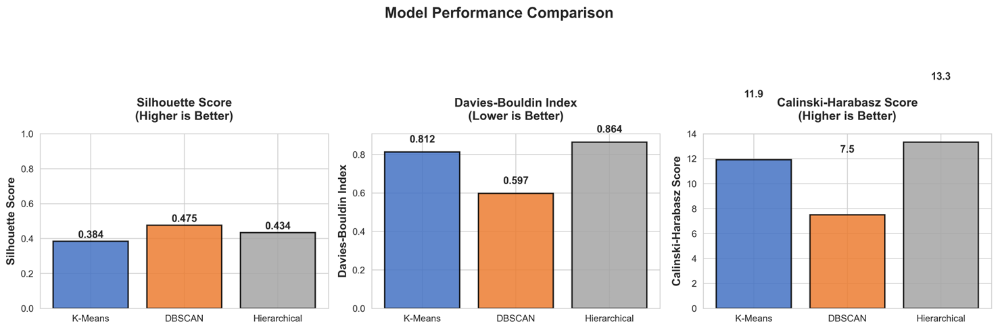
MODEL PERFORMANCE COMPARISON
Metric | K-Means | DBSCAN | Hierarchical | Interpretation
Silhouette Score | 0.384 | 0.475 | 0.434 | Higher is better (max 1.0)
Davies-Bouldin Index | 0.812 | 0.597 | 0.864 | Lower is better (min 0.0)
Calinski-Harabasz Index | 11.9 | 7.5 | 13.3 | Higher is better

Slide 15
MODEL PERFORMANCE COMPARISON
Key Findings:
DBSCAN achieved the best overall performance:
Highest Silhouette Score (0.475) indicating better-defined clusters
Lowest Davies-Bouldin Index (0.597) showing superior cluster separation
Effective at detecting outlier stations and arbitrary-shaped clusters
Hierarchical Clustering showed highest Calinski-Harabasz Index (13.3), indicating strong inter-cluster separation
K-Means provided interpretable results with good balance across metrics

Slide 16
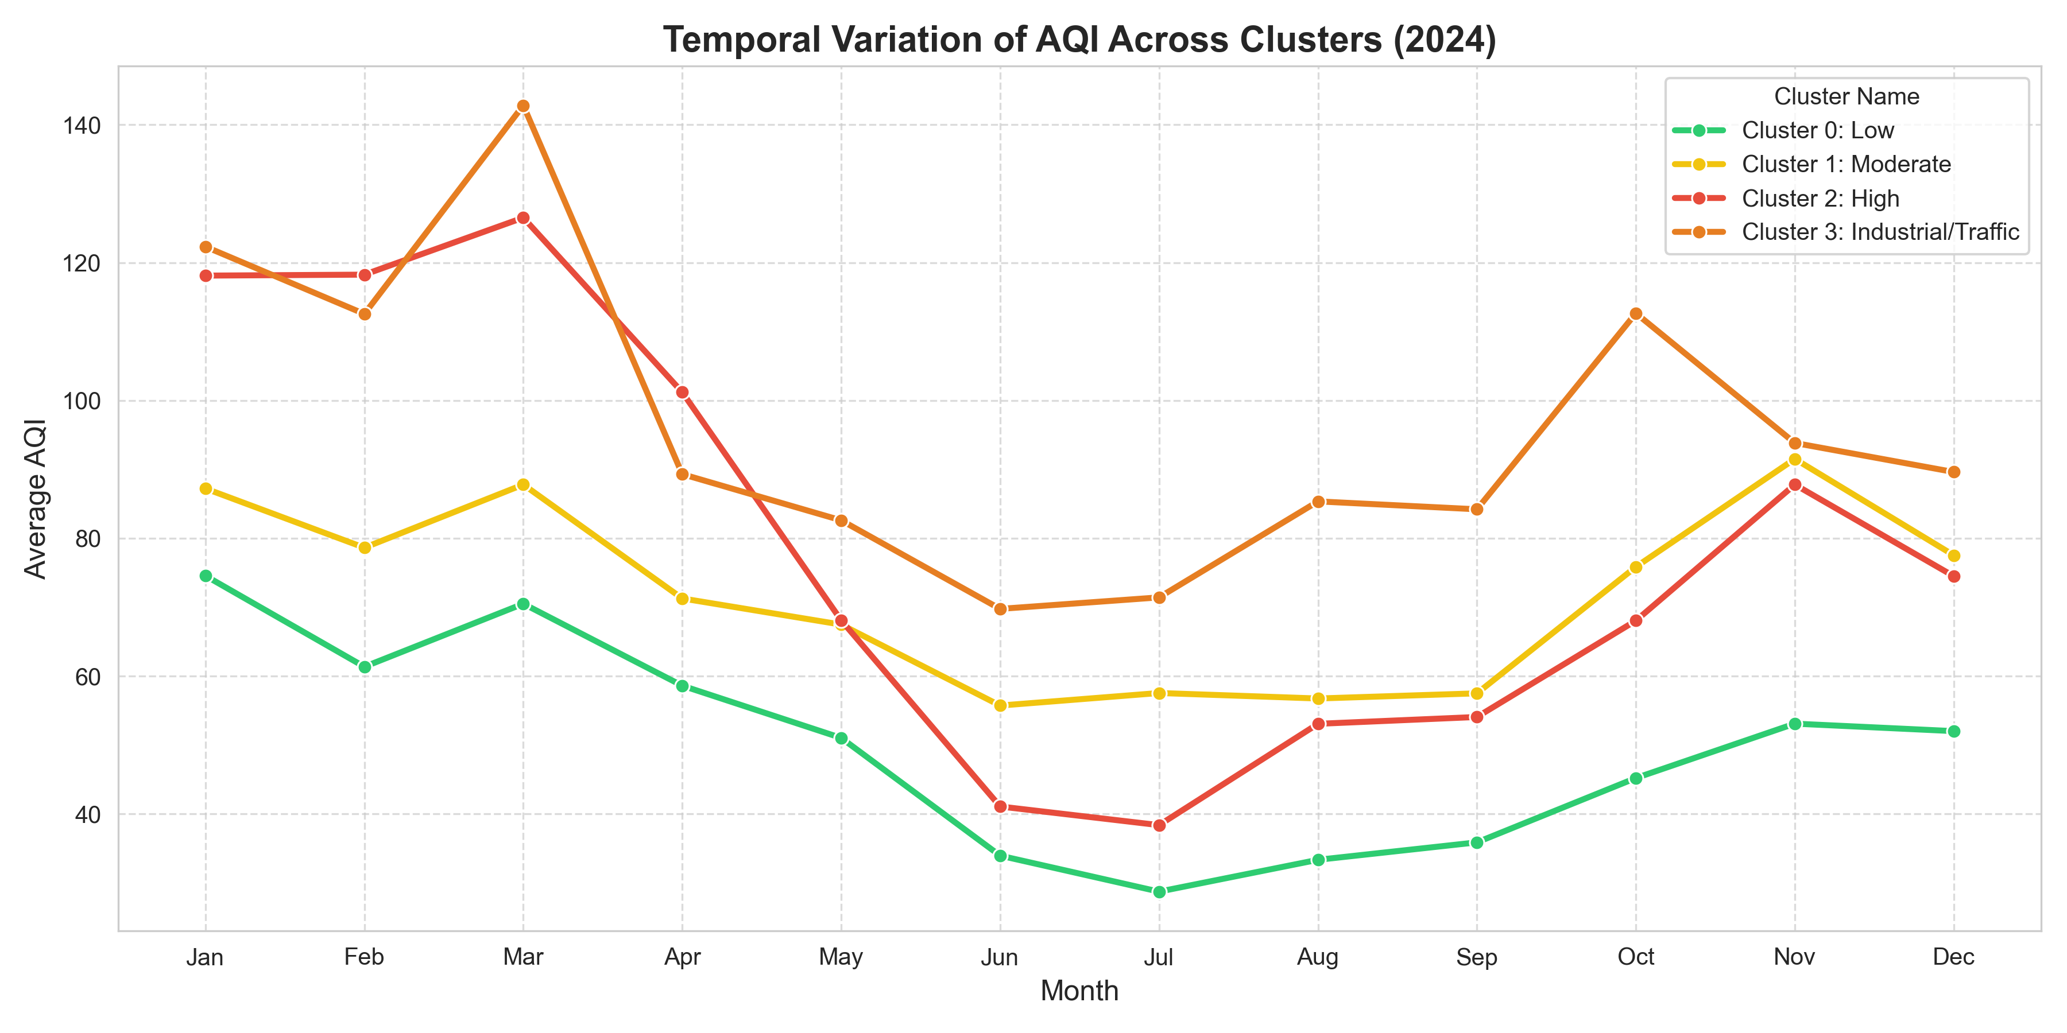
Temporal Patterns

Slide 17
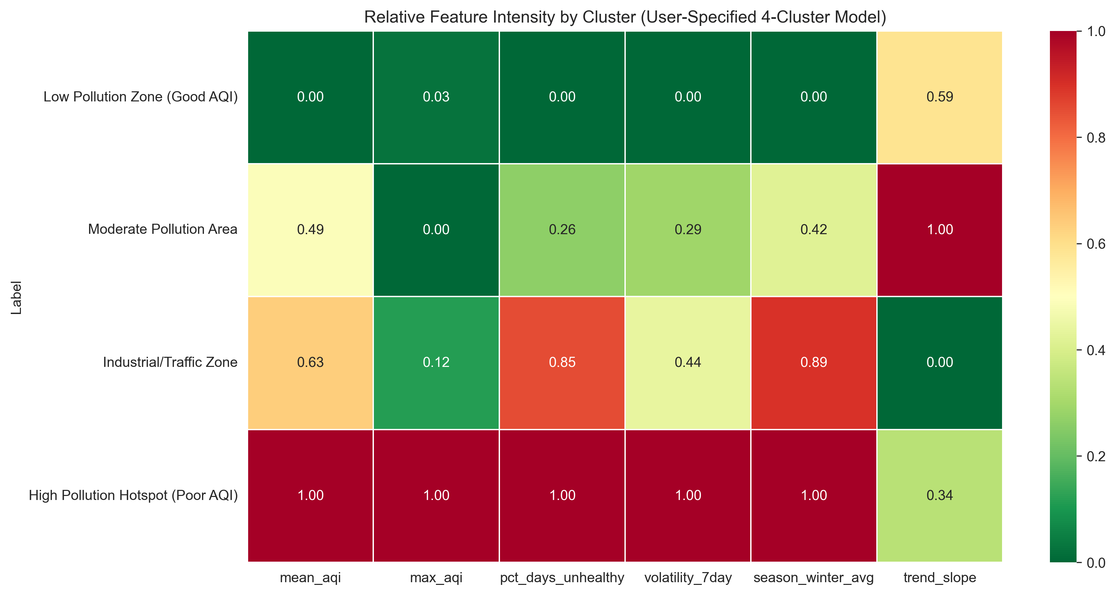
Temporal Patterns (Heat map)

Slide 18
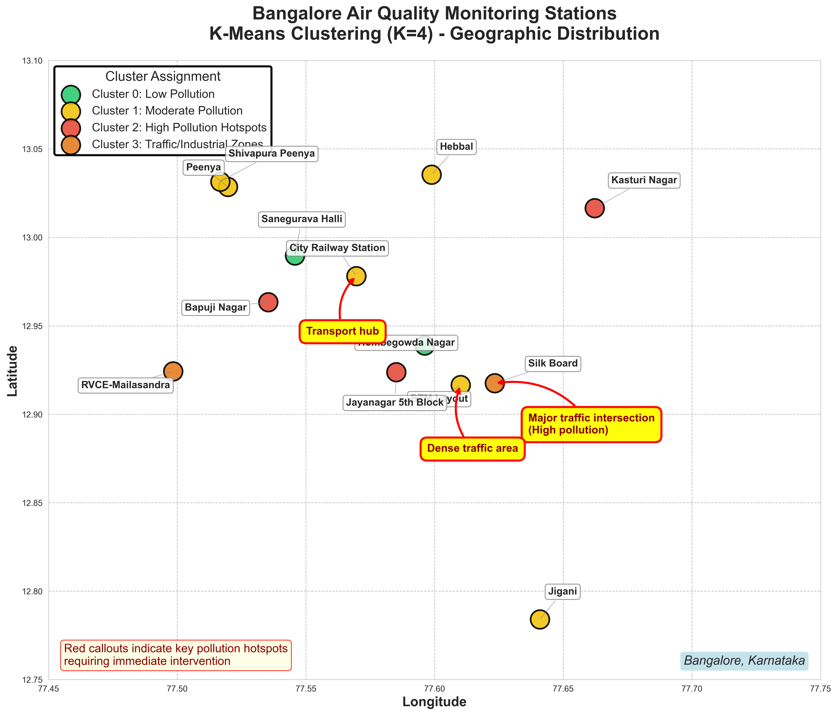
Spatial Distribution of Clusters

Slide 19
Key Insights & Findings
1. Clear Pollution Hotspots Identified
- Successfully identified distinct pollution hotspots in Bangalore
- 2 stations (K-Means) to 8 stations (DBSCAN) show poor air quality
2. Traffic & Industrial Influence
- High pollution clusters correlate with heavy traffic zones
- Silk Board: Major traffic intersection
- RVCE-Mailasandra: Possible industrial emissions

Slide 20
Key Insights & Findings
3. Model Performance
- DBSCAN emerged as most effective for anomaly detection, but could not make clusters properly.
- K-Means provided interpretable cluster separation

Slide 21
Limitations
Does not include meteorological factors (wind, temperature, humidity)
The sensors are not available in every location to retrieve the data
Missing data periods may affect cluster assignments

Slide 22
Conclusion
This project demonstrated the application of clustering techniques to identify pollution hotspots in Bangalore using CPCB air quality data.
Key Achievements:
Implemented and compared three clustering algorithms
Successfully normalized multi-pollutant sensor data
Identified distinct pollution zones across Bangalore
Provided spatial visualization of air quality patterns

Slide 23
Thank You!

